Slide 1

DATA CURATION & MODELING
Shanmuga Sai Kiran

Slide 2
Content
Problem Statement
Data Source
Profiling Insights
Technical Details
ETL Workflow
Logical Data Map
Star Schema
ML Workflow
ETL & ML Demo
Q & A

Slide 3
Problem Statement
To predict which country will win 2022 FIFA World Cup

Slide 4
Data Source
International football results from 1872 to 2020

Slide 5
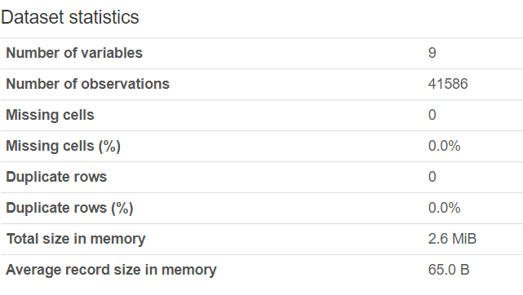
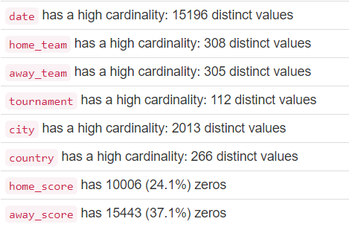
Profiling Insights

Slide 6
Technical Details
Hadoop cluster is at the core to my project
Spark SQL – To apply filtering
PySpark – Spark job’s (Transformation, Cleaning, Filtering, and storing)
GCS – For staging the data
BigQuery – Data Warehouse
Apache Airflow – Orchestrator

Slide 7





ETL Workflow
Create Cluster
Spark Job
Copy to DW
Del Cluster
Del GCS Data
Acquisition
Curation
Storage

Slide 8
Logical Data Map
Target
Source
Transformations
Table Name | Column Name | Data Type | Table Type
DB Name | Table Name | Column Name | Data Type
Primary Key date_id, game_id
date | date_id | integer | dim
srh_project | results | date | string
Applied schema on every field StructType( [ StructField("date", StringType(), True), …])
date | date | date | dim
srh_project | results | home_team | string
game | game_id | integer | dim
srh_project | results | away_team | string
def to_date_(col, formats=("MM/dd/yyyy", "yyyy-MM-dd", "dd-MM-yyyy", "dd/MM/yyyy")): # Spark 2.2 or later syntax, for < 2.2 use unix_timestamp and cast return coalesce(*[to_date(col, f) for f in formats])
game | home_team | string | dim
srh_project | results | home_score | integer
game | away_team | string | dim
srh_project | results | away_score | integer
raw_data.withColumn("date_id", monotonically_increasing_id()+1)
game | tournament | string | dim
srh_project | results | tournamnet | string
game | city | string | dim
select * from results where tournament == ‘FIFA World Cup’
srh_project | results | city | string
game | country | string | dim
Select case when ISNUMERIC(ColumnName)=1 then ColumnName else -1 end
srh_project | results | country | string
game | neutral | boolean | dim
srh_project | results | neutral | boolean
initcap(home_team)
facts | game_id | integer | fact
initcap(away_team)
facts | date_id | integer | fact
initcap(city)
facts | home_score | integer | fact
initcap(country)
facts | away_score | integer | fact
FIFA.withColumn("date", to_date_("date"))
date_dim = results.select('date_id', 'date')
team_loc_dim = results.select('game_id', 'home_team', 'away_team', 'tournament', 'city', 'country', 'neutral')
fifa_fact = results.select("date_id", "game_id", "home_score", "away_score")

Slide 9
Star Schema
Football Facts Table
date_id (FK)
game_id (FK)
Game Dimension
Date Dimension
home_score(fact)
game_id (PK)
date_id (PK)
date
Away_score (fact)
home_team
away_team
city
country
neutral

Slide 10
ML Workflow
BQ Data
ML Model
Prediction

Slide 11
ETL & ML Demo

Slide 12
Q&A

